Slide 1




Elementz Challenge
Hackathon 2025 – 22nd Feb to 23 Feb
TEAM WONK-E

Slide 2
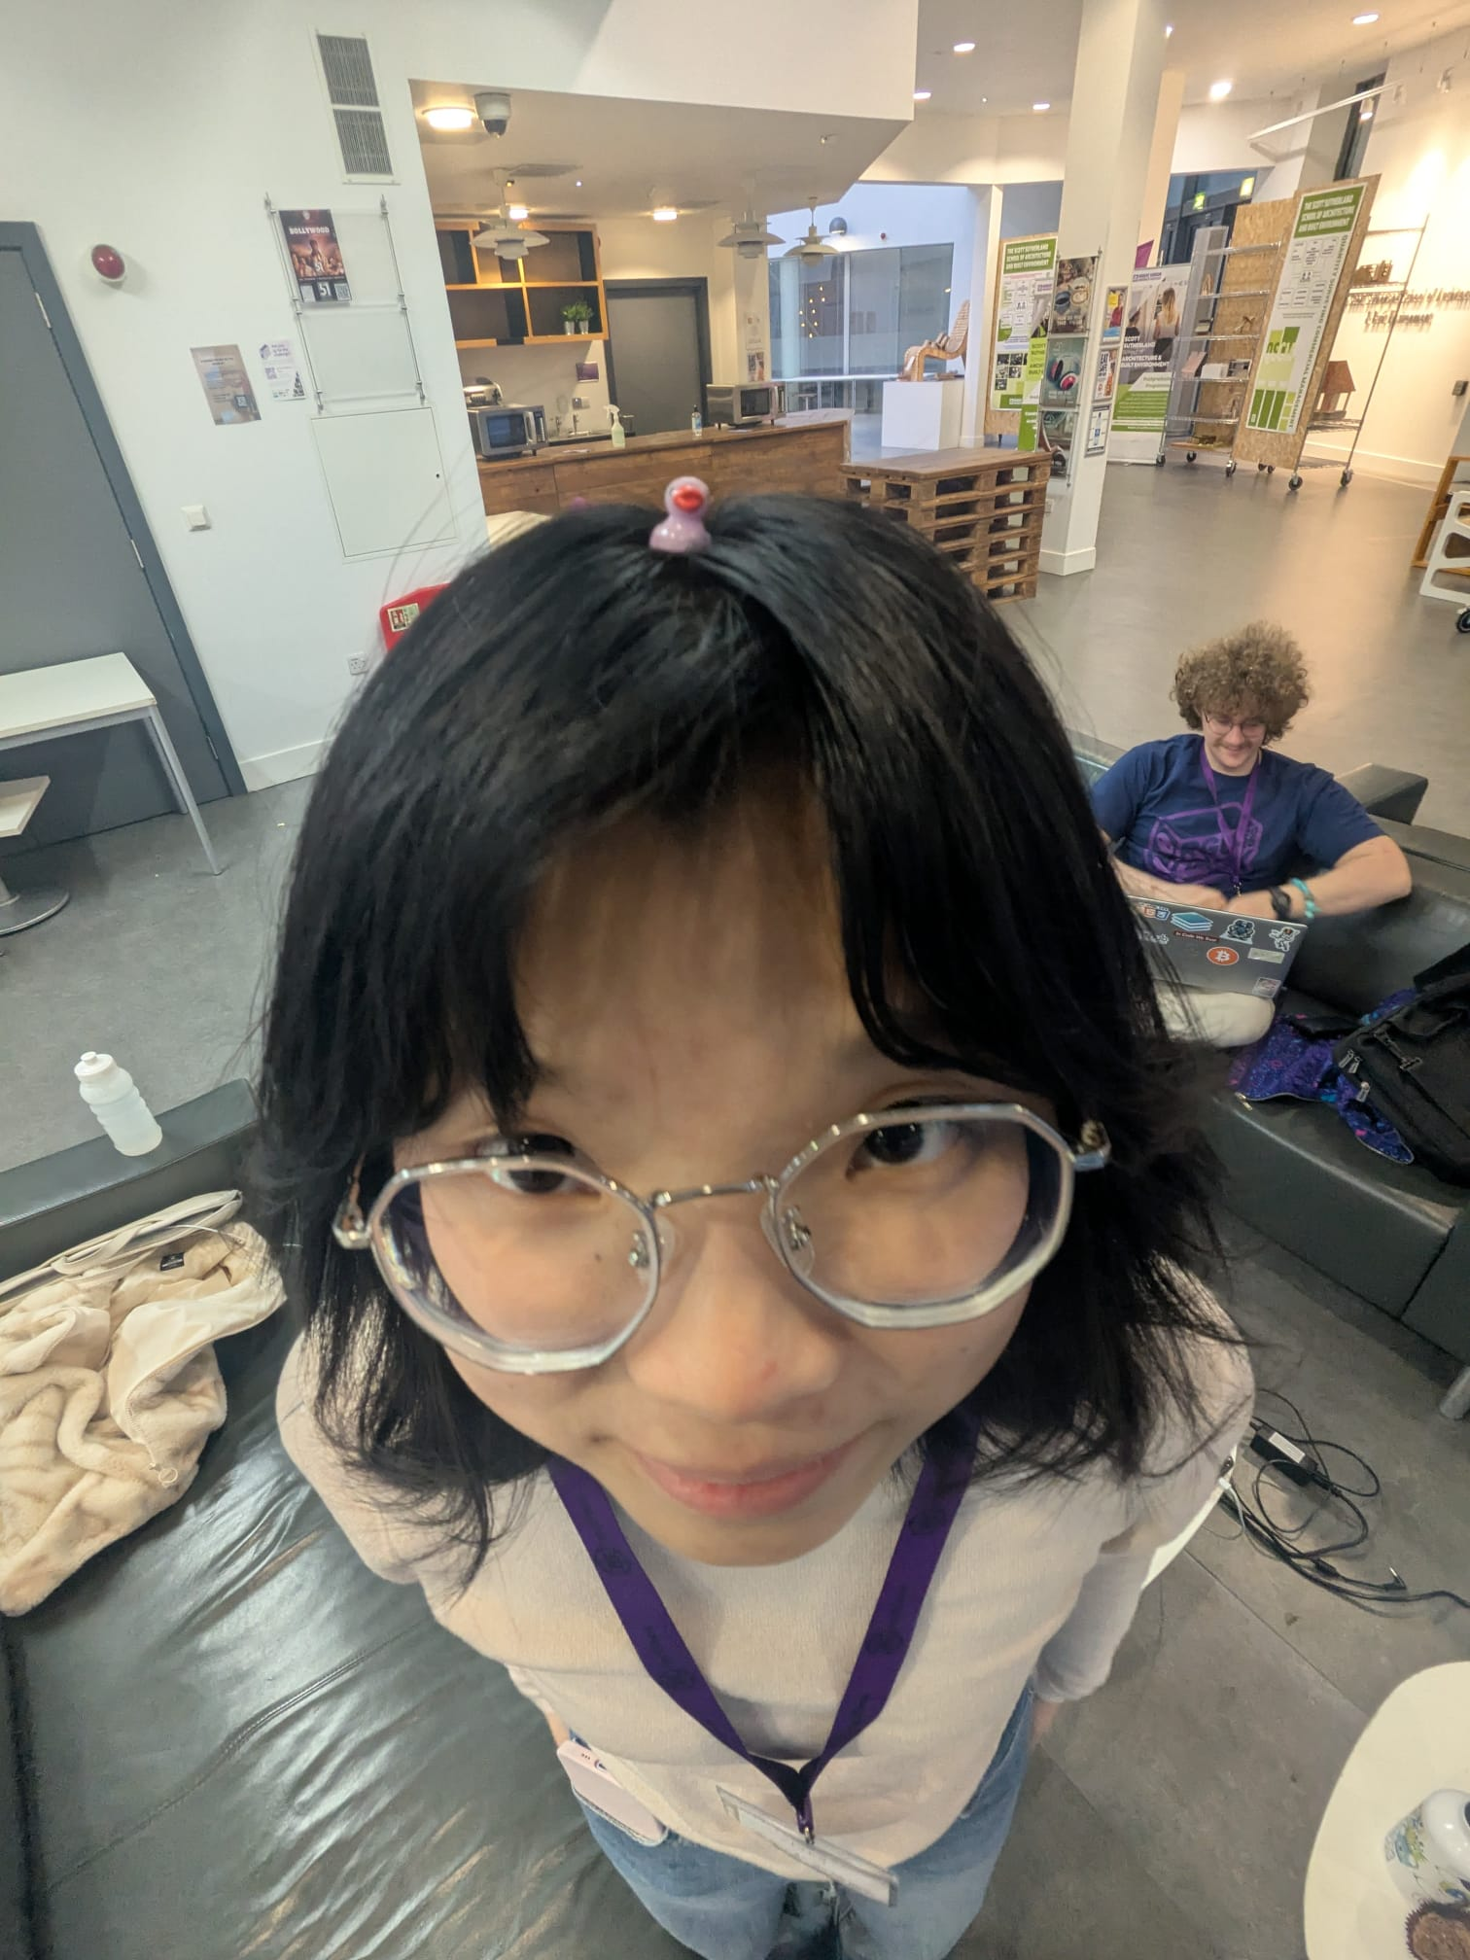
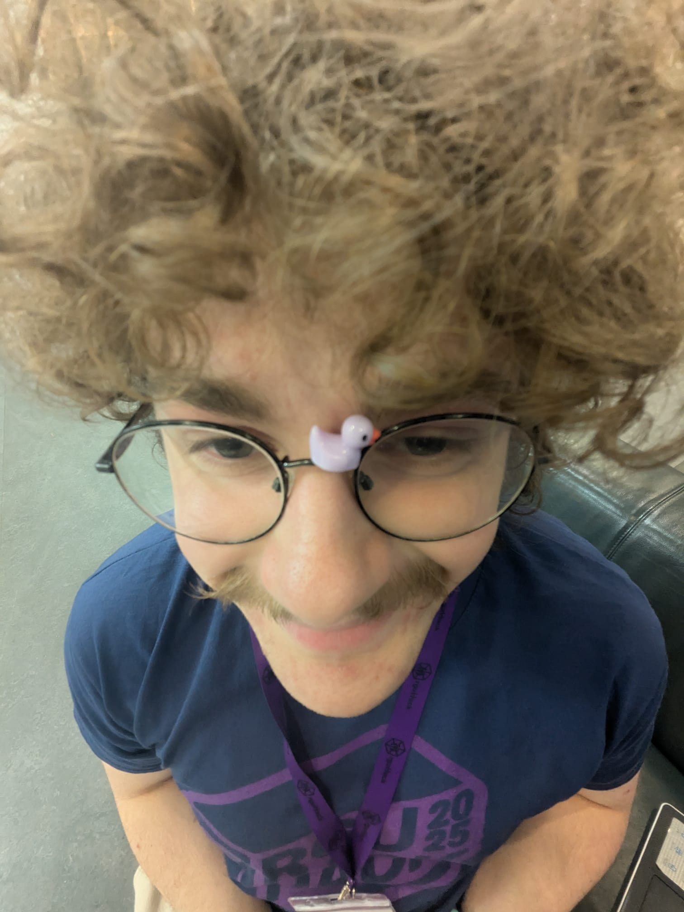
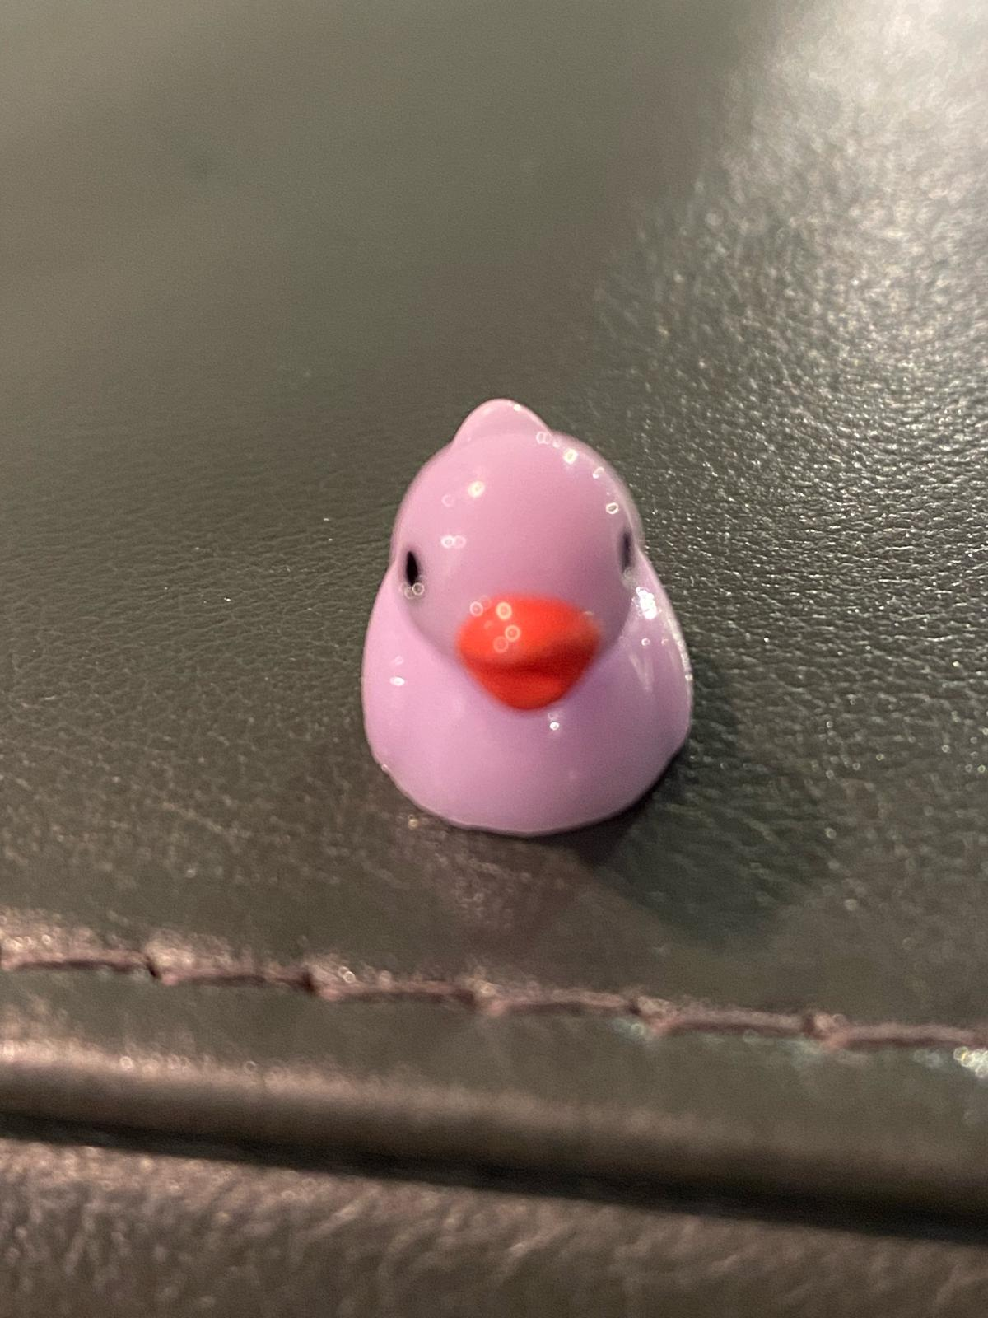
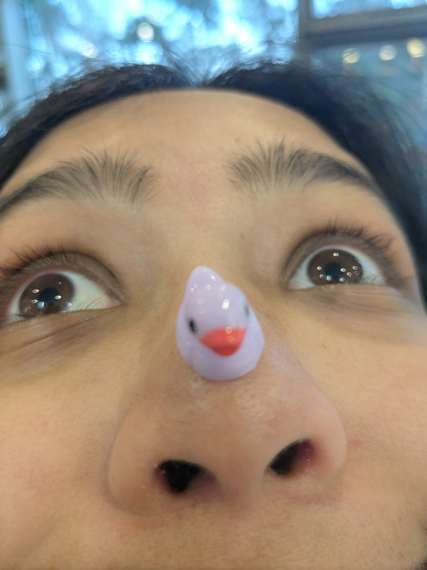
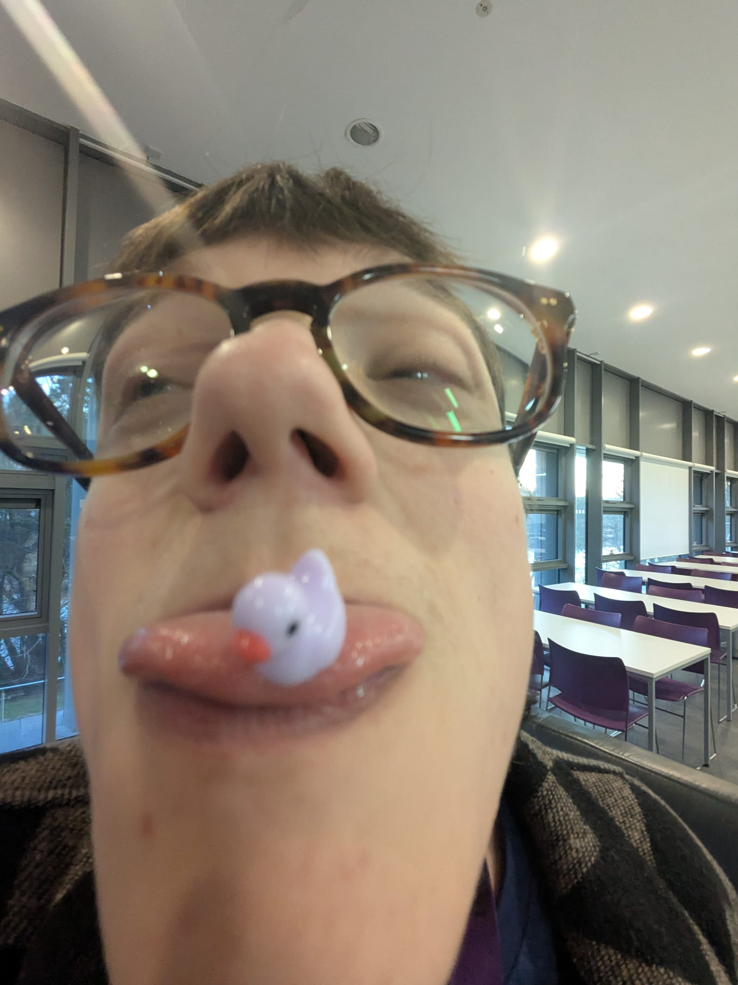
Meet the (very sleep deprived) Team!
Wanjie Zhong
Hours of Sleep = 1
Oliver Souter
Hours of Sleep = 0.10
Eloise
Hours of Sleep = 99+
Navya Shiju
Hours of Sleep = 2
Kai Ferguson
Hours of Sleep = 2

Slide 3
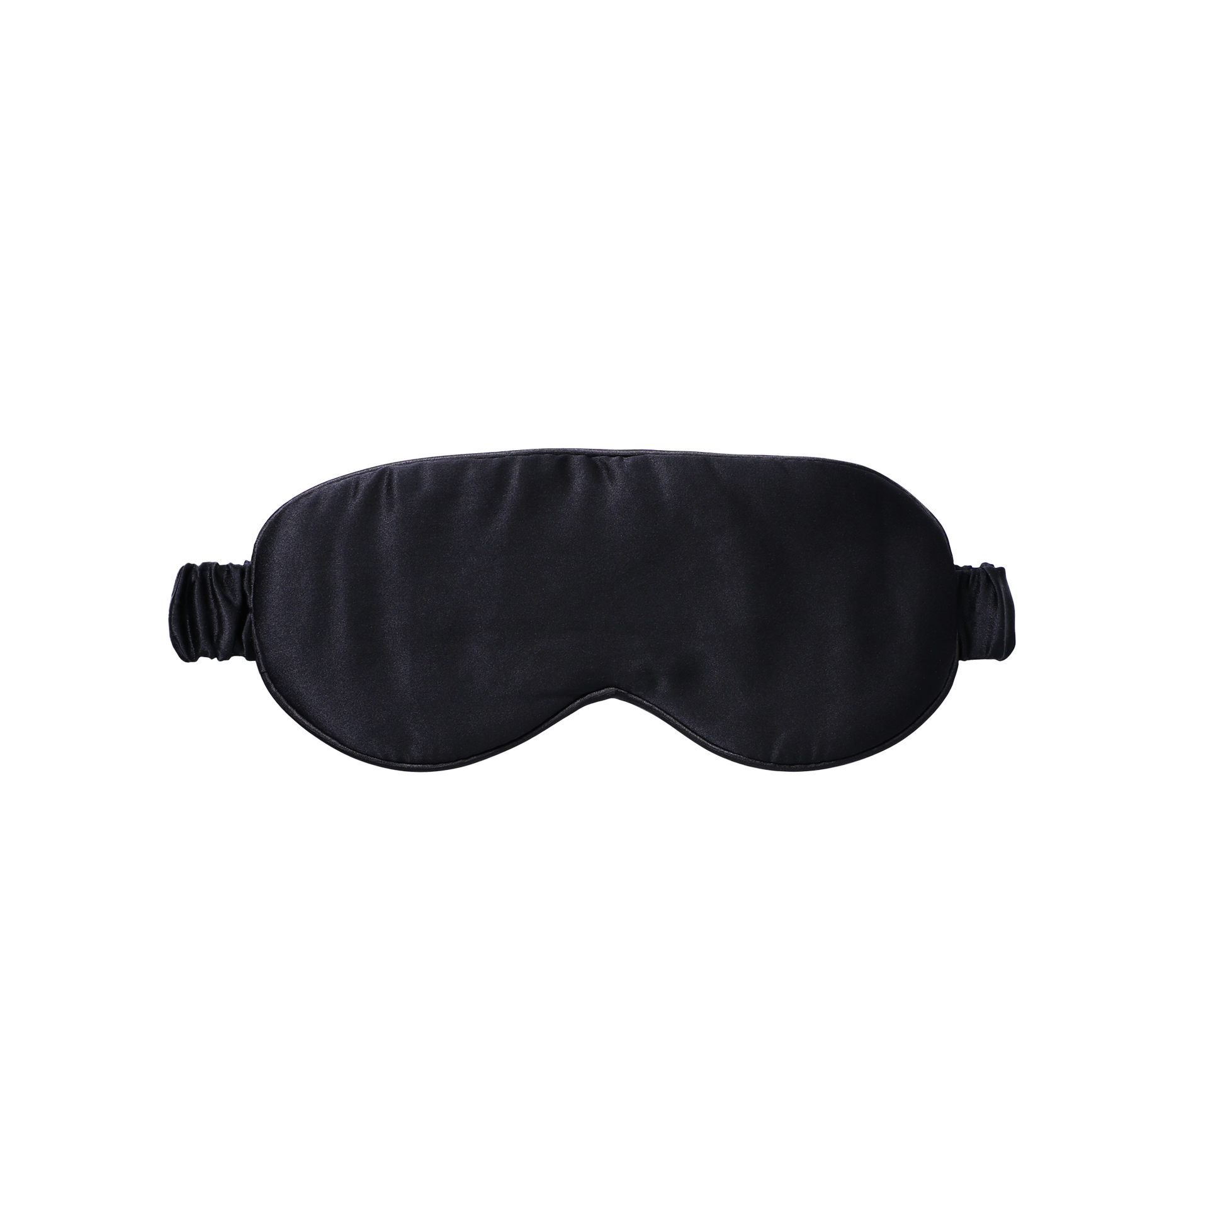






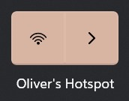
Tools Used

Slide 4

Solution Functionality & Features
Plotting points of interest from the API on a 3D globe
Loading information from the API
Checking weather forecast
Adding filters to the data to view specific pipelines
Viewing of the vessels and their information from the API

Slide 5


Challenges and Learning Experiences
Learning a new framework (CesiumJS)
Debugging with new teammates
Handling multiple API data
Handling geo-spatial information

Slide 6



Visions for the Future
Short-Term
Long – Term
Improve the performance by enabling real-time API calls so that the globe updates in real-time

Slide 7
Demo
Please enjoy our following demo!
Hopefully it works and we don't get hit by the "demo curse" :)

Slide 8
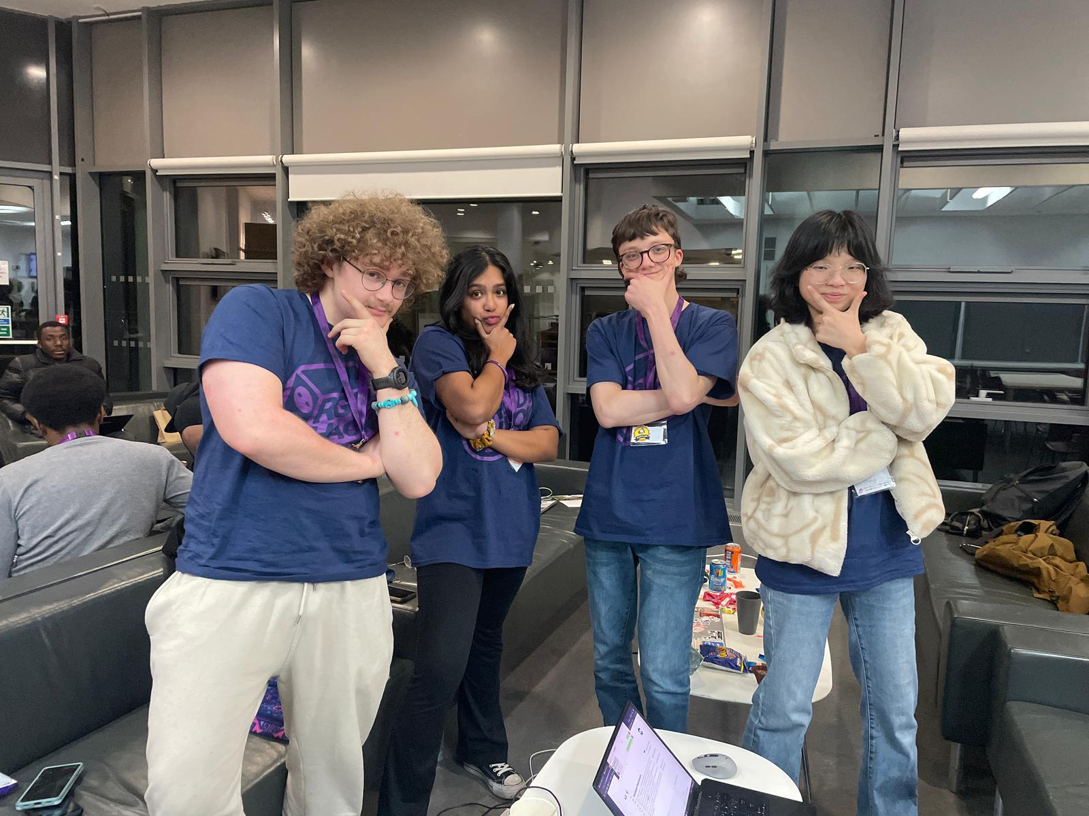
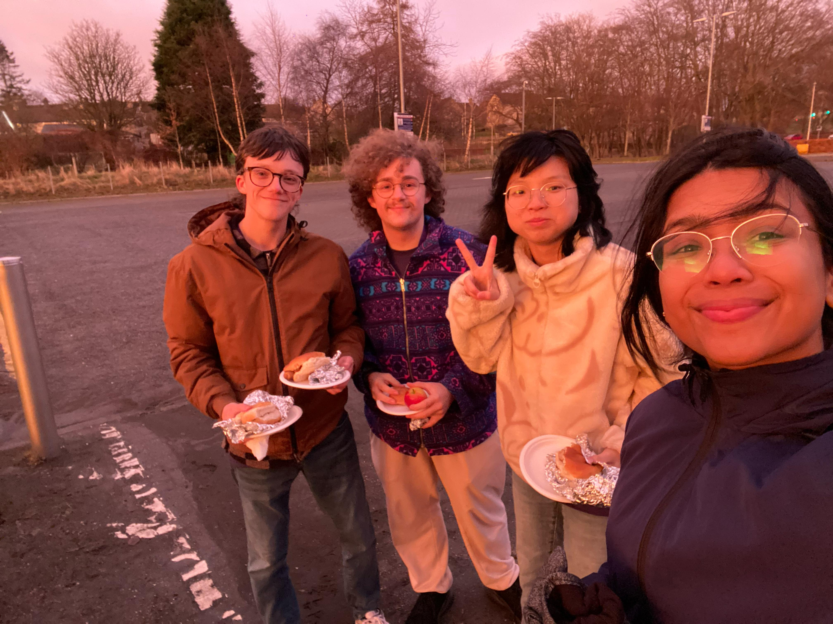

"That'll do Donkey, that'll do" - Shrek, 2001

